Slide 1


RxJava and SWT: Out with Events, in with FRP
Ned Twigg
All code examples available here
https://github.com/diffplug/rxjava_and_swt

Slide 2
What is Functional Reactive Programming
A buzzword for event-driven programming
But this time the events are COMPOSABLE
Epigrams in Programming #9 (Alan Perlis 1988, 30-50 years of experience)
It is better to have 100 functions operate on one data structure than 10 functions on 10 data structures.
SWT – ~30 event / listener pairs, 0 methods
RxJava – 1 event / listener pair, gazillion methods

Slide 3


What makes RxJava more “composable”?
In SWT, we add an event handler like this:
In RxJava, we add an event handler like this:
Observable is a pipe we can filter, map, and more!

Slide 4
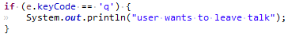
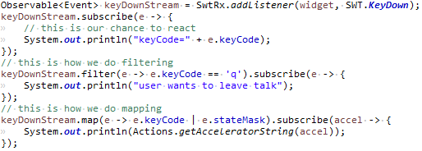

What good is a pipe?
Event callbacks and event streams are the same
every if statement = filter
every new value = map
A keypress will cause a cascade of actions across your program
With Events, that cascade flows through ad-hoc function calls
With Observables, that cascade is explicitly modeled and comes with batteries
Especially for time – debounce, sample, throttle, etc.

Slide 5

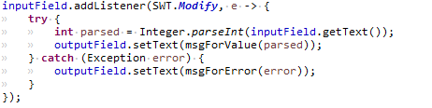
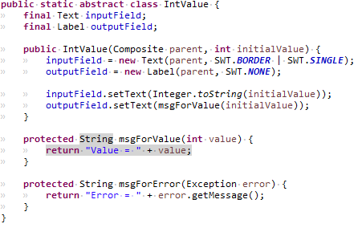
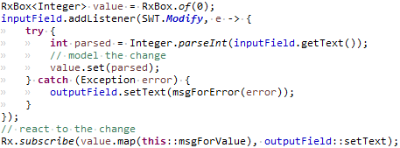
Events – nested calls
Observable – decouples the event’s source
from its effects

Slide 6
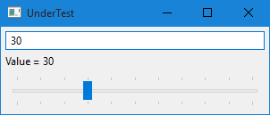
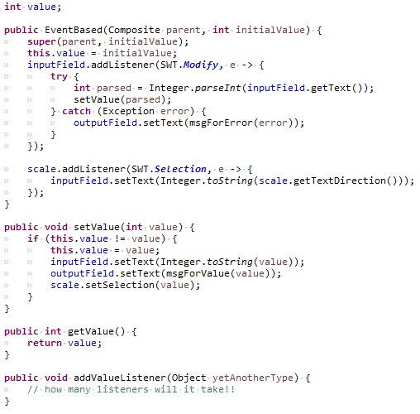
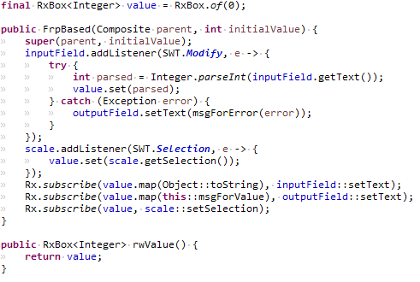
Just a smidge harder…
Events – nested calls
Observable – decouples the event’s source
from its effects

Slide 7
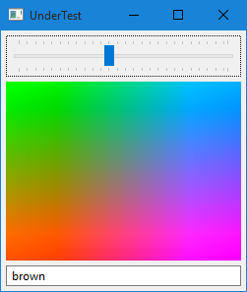
Still to come, pending time from dry runs
Error handling
Either<Value, Exception> vs handling them directly
Non-SWT thread issues (stock picker example)
SwtExec.async().guardOn(widget).subscribeTo(rxValue, action);
Tour-de-force colored stock picker example

Slide 8



Evaluate the Sessions
Sign in and vote at eclipsecon.org
- 1
0
+ 1

